Slide 1
Chapter 12: File System Implementation
These are the textbook slides of Operating System Concepts by Silberschatz, Galvin and Gagne. This is the prescribed textbook for this course. Some of the slides have been modified/edited. New slides have also been added by the instructor from web-based sources that are freely available in the public domain.

Slide 2
Chapter 12: File System Implementation
File-System Structure
File-System Implementation
Directory Implementation
Allocation Methods
Free-Space Management
Efficiency and Performance
Recovery
NFS

Slide 3
File-System Structure
File structure
  Logical storage unit
  Collection of related information
File system resides on secondary storage (disks)
  Provided user interface to storage, mapping logical to physical
  Provides efficient and convenient access to disk by allowing data to be stored, located retrieved easily
Disk provides in-place rewrite and random access
  I/O transfers performed in blocks of sectors (usually 512 bytes)
File control block – storage structure consisting of information about a file
Device driver controls the physical device
File system organized into layers

Slide 4

Layered File System

Slide 5

File-System Implementation
Per-file File Control Block (FCB) contains many details about the file
  inode number, permissions, size, dates
Inode is a data structure, which describes a file system object (e.g., file, directory etc.)
  e.g., attributes such as last time of access, last time of update, disk block info concerning the object’s data, permissions etc.
  Inode data structure is primarily for a Unix-style file system

Slide 6
Virtual File Systems
Virtual File Systems (VFS) on Unix provide an object-oriented way of implementing file systems
VFS allows the same system call interface (the API) to be used for different types of file systems
  Separates file-system generic operations from implementation details
  Implementation can be one of many file systems types, or network file system
    Implements vnodes which hold inodes or network file details
  Then dispatches operation to appropriate file system implementation routines
The API is to the VFS interface, rather than any specific type of file system

Slide 7
Directory Implementation
Linear list of file names with pointer to the data blocks
  Simple to program
  Time-consuming to execute
    Linear search time
    Could keep ordered alphabetically via linked list or use B+ tree
Hash Table – linear list with hash data structure
  Decreases directory search time
  Collisions – situations where two file names hash to the same location
  Only good if entries are fixed size, or use chained-overflow method

Slide 8
Allocation Methods
An allocation method refers to how disk blocks are allocated for files:
Contiguous allocation – each file occupies set of contiguous blocks
Linked allocation – Each file is a linked list of disk blocks: blocks may be scattered anywhere on the disk
Indexed allocation – Each file has its own index block(s) of pointers to its data blocks
  Need index table
  Dynamic access, but have overhead of index block
Extent-based systems – Many newer file systems (i.e., Veritas File System) use a modified contiguous allocation scheme
  Extent-based file systems allocate disk blocks in extents
  An extent is a contiguous block of disks
  Extents are allocated for file allocation
  A file consists of one or more extents

Slide 9
Performance
Best method depends on file access type
  Contiguous great for sequential and random
Linked good for sequential, not random
Indexed more complex

Slide 10
File-Allocation Table
File Allocation Table (FAT) is an index table that is statically allocated at the time of formatting
Contains entries for each contiguous area of disk storage (cluster)
Each entry contains info such as unused disk space

Slide 11
Free-Space Management
File system maintains free-space list to track available blocks/clusters
  (Using term “block” for simplicity)
Bit vector or bit map (n blocks)
0
1
2
n-1
…
1 ⇒ block[i] free
0 ⇒ block[i] occupied
bit[i] =

Slide 12
Page Cache
A page cache caches pages rather than disk blocks using virtual memory techniques and addresses

Slide 13
Recovery
Consistency checking – compares data in directory structure with data blocks on disk, and tries to fix inconsistencies
  Can be slow and sometimes fails
Use system programs to back up data from disk to another storage device (magnetic tape, other magnetic disk, optical)
Recover lost file or disk by restoring data from backup

Slide 14
Log Structured File Systems
Log structured (or journaling) file systems record each metadata update to the file system as a transaction
All transactions are written to a log
  A transaction is considered committed once it is written to the log (sequentially)

Slide 15
NFS
Interconnected workstations viewed as a set of independent machines with independent file systems, which allows sharing among these file systems in a transparent manner
  A remote directory is mounted over a local file system directory
    The mounted directory looks like an integral subtree of the local file system, replacing the subtree descending from the local directory
  Subject to access-rights accreditation, potentially any file system (or directory within a file system), can be mounted remotely on top of any local directory

Slide 16
NFS (Cont.)
NFS is designed to operate in a heterogeneous environment of different machines, operating systems, and network architectures; the NFS specifications independent of these media
This independence is achieved through the use of RPC primitives built on top of an External Data Representation (XDR) protocol used between two implementation-independent interfaces
The NFS specification distinguishes between the services provided by a mount mechanism and the actual remote-file-access services

Slide 17
Three Major Layers of NFS Architecture
UNIX file-system interface (based on the open, read, write, and close calls, and file descriptors)
Virtual File System (VFS) layer – distinguishes local files from remote ones, and local files are further distinguished according to their file-system types
  The VFS activates file-system-specific operations to handle local requests according to their file-system types
  Calls the NFS protocol procedures for remote requests
NFS service layer – bottom layer of the architecture
  Implements the NFS protocol

Slide 18
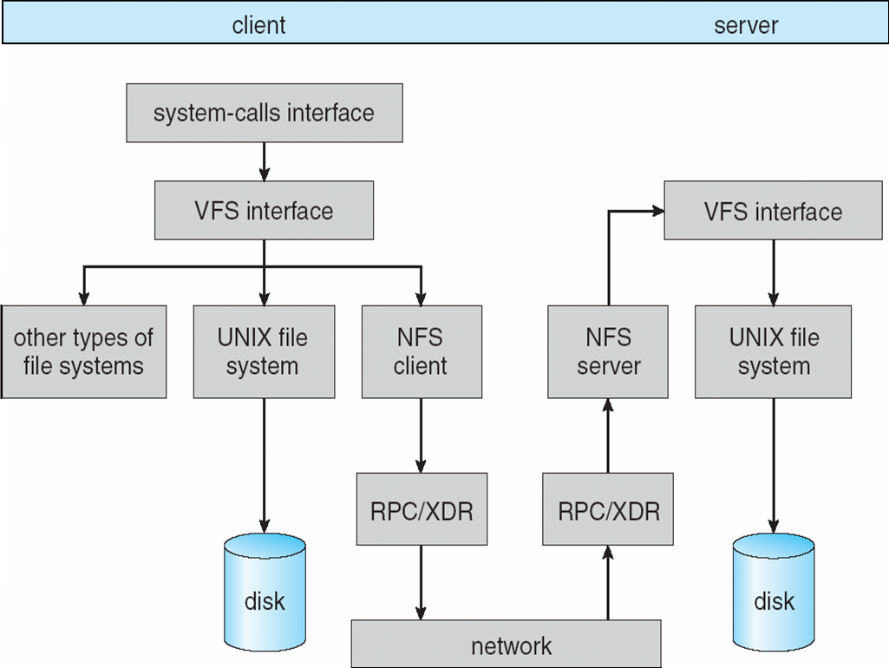
Schematic View of NFS Architecture

Slide 19
End of Chapter 12

